Slide 1
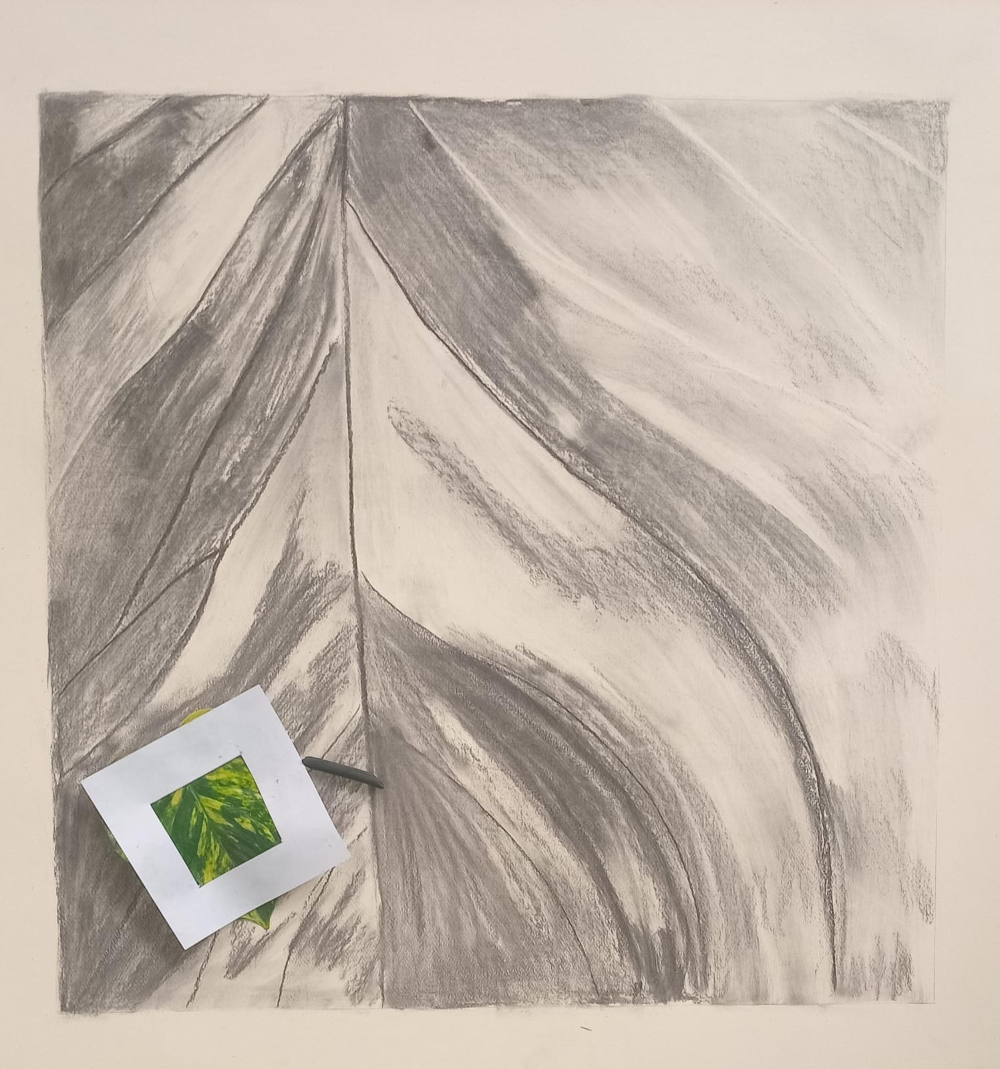
DESIGN JOURNEY 2025
Aman Saif _ 2025-ARCH-14
Course : foundation studio
“EVERY DESIGN STSRTS WITH A LINE”

Slide 2
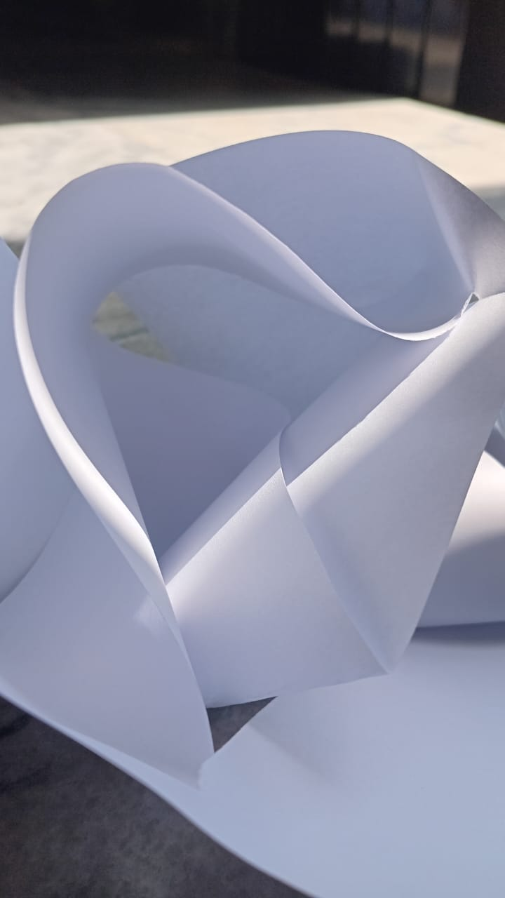
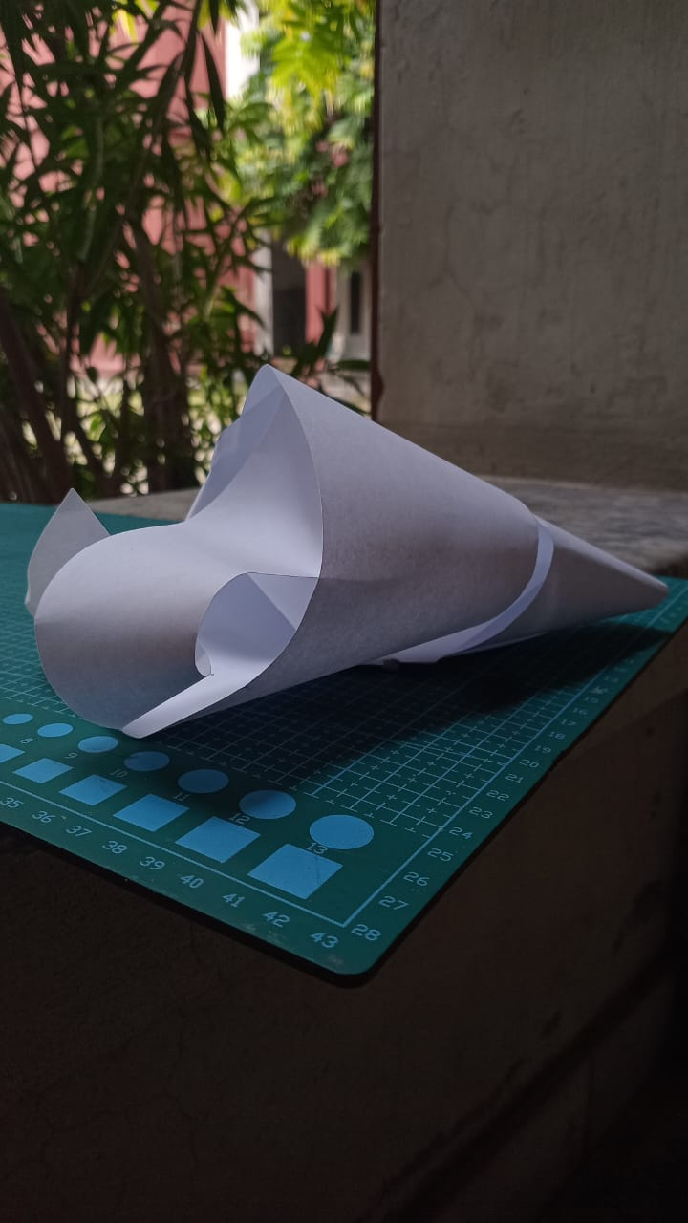
EXPLORING FORMS THROUGH PAPER MODELS
I began my journey by experimenting with paper – folding, cutting, and layering to discover geometric balance
These models help me understand how light and shadow interact with form
Each paper structure represents an early step in learning 3d composition

Slide 3
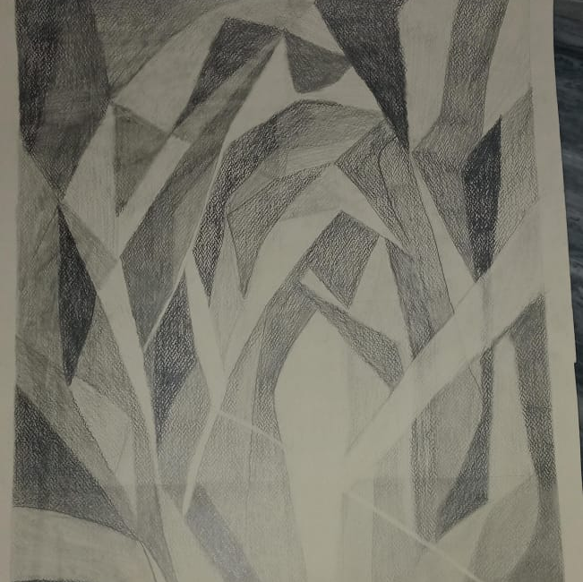
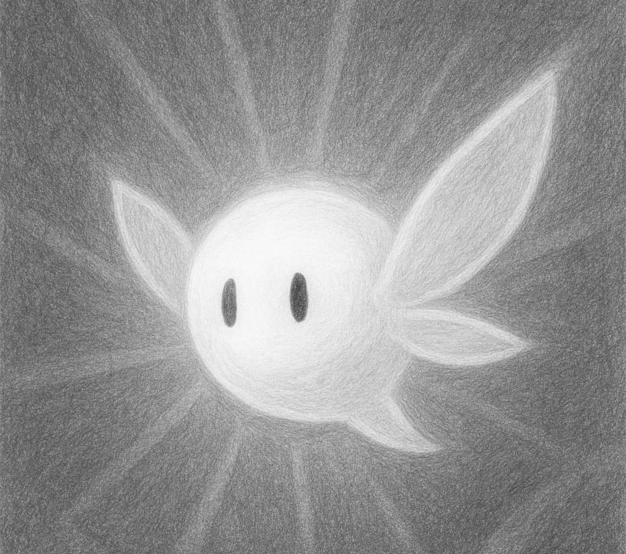
CHARACTER EXPLORATION – “LUMO”
“Meet Lumo, a character created to express the idea of light , growth and transformation”
“Lumo represents an imaginative being that glows from within – symbolizes creativity emerging from darkness”
“through Lumo I explored proportions , expression and how design can communicate beyond words”
“Where imagination begins to glow.”

Slide 4
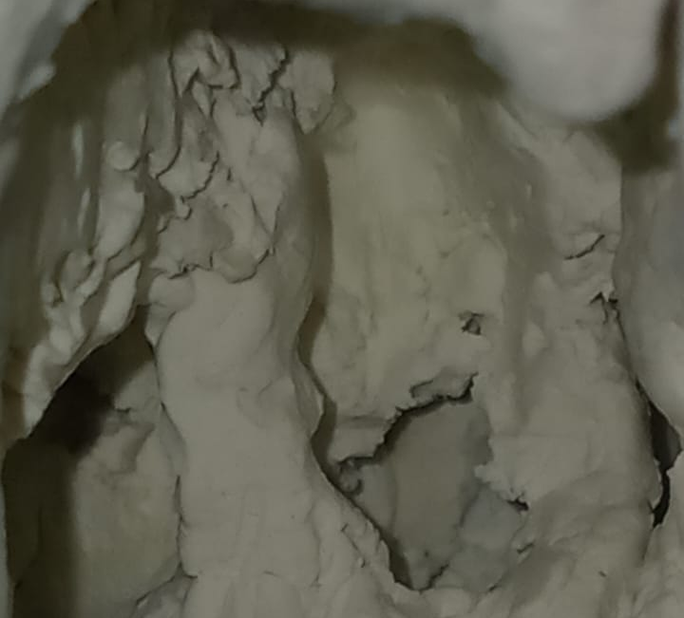
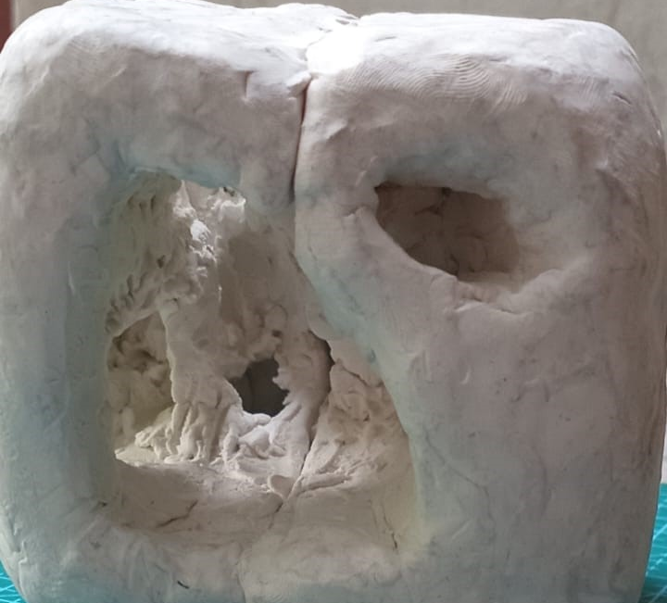
TRANSFORMING 2D SPACES OF LUMO INTO 3D CLAY FORM
“In this phase, I translated Lumo`s 2D design sketches into a 3D clay model”
“the goal was to explore how Lumo`s spatial qualities – light, movement and voids – could exist in real form”
“I focused on converting its abstract shapes into physical volumes while keeping the sense of inner glow”
Follow my creative journey @through-arch-eyes

